Slide 1

The UNIX File System
Mina Gabriel

Slide 2
Introduction
The UNIX operating system is built around the concept of a filesystem which is used to store all of the information that constitutes the long-term state of the system.
This state includes the operating system kernel itself, the executable files for the commands supported by the operating system, configuration information, temporary workfiles, user data, and various special files that are used to give controlled access to system hardware and operating system functions.

Slide 3
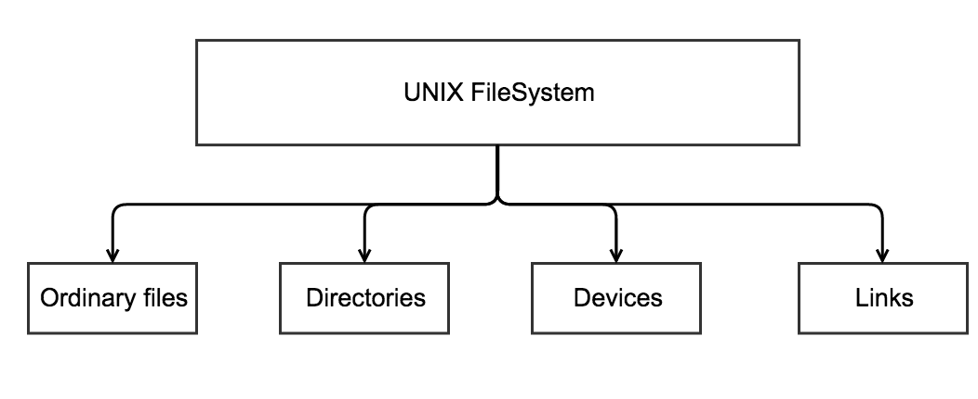
Every item stored in a UNIX filesystem belongs to one of four types:

Slide 4
Ordinary files
Ordinary files can contain text, data, or program information. Files cannot contain other files or directories.
Unlike other operating systems, UNIX filenames are not broken into a name part and an extension part, Instead they can contain any keyboard character except for '/' and be up to 256 characters long.
Putting spaces in filenames also makes them difficult to manipulate - rather use the underscore '_'.

Slide 5
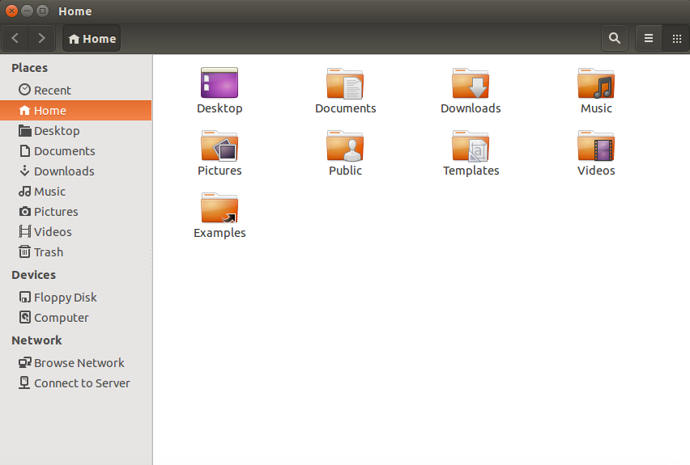
Directories
Directories are containers or folders that hold files, and other directories.

Slide 6
Devices
To provide applications with easy access to hardware devices, UNIX allows them to be used in much the same way as ordinary files. There are two types of devices in UNIX - block-oriented devices which transfer data in blocks (e.g. hard disks) and character-oriented devices that transfer data on a byte-by-byte basis (e.g. modems and dumb terminals).

Slide 7
Links
A link is a pointer to another file. There are two types of links - a hard link to a file is indistinguishable from the file itself. A soft link (or symbolic link) provides an indirect pointer or shortcut to a file. A soft link is implemented as a directory file entry containing a pathname.

Slide 8
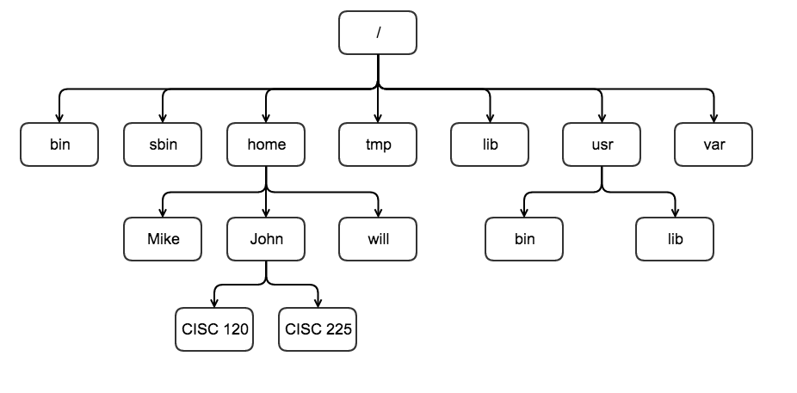
UNIX Directory Structure
The UNIX filesystem is laid out as a hierarchical tree structure which is anchored at a special top-level directory known as the root (designated by a slash '/'). Because of the tree structure, a directory can have many child directories, but only one parent directory.

Slide 9
To specify a location in the directory hierarchy, we must specify a path through the tree.
The path to a location can be defined by an absolute path from the root /, or as a relative path from the current working directory.
To specify a path, each directory along the route from the source to the destination must be included in the path, with each directory in the sequence being separated by a slash.
To help with the specification of relative paths, UNIX provides the shorthand "." for the current directory and ".." for the parent directory.

Slide 10
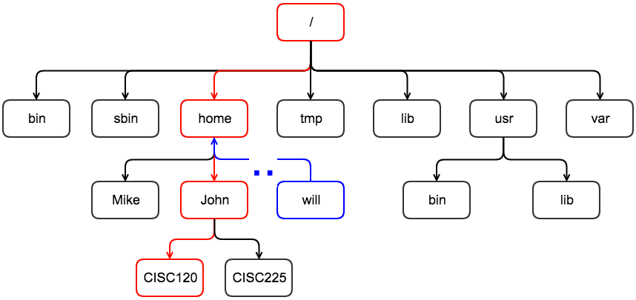
Example
For example, the absolute path to the directory “CISC120” is /home/John/CISC120, while the relative path to this directory from ”Will” is ../John/CISC120.

Slide 11
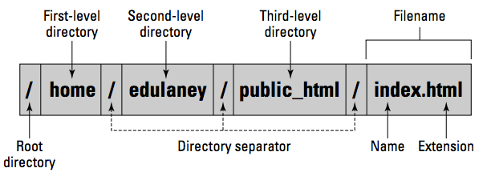
To locate a file, you need more than just the filename. You also need information about the directory hierarchy. The extended filename, showing the full hierarchy of directories leading to the file, is the pathname. As the name implies, it’s the path to the file through the maze of the file system.

Slide 12
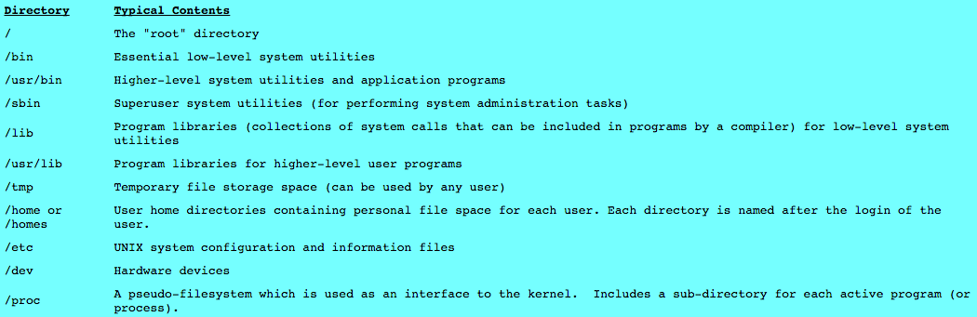
Finding your way around the file system is easier if you know the purpose of these directories.

Slide 13
~ Tilde Symbol
When you log into UNIX, your current working directory is your user home directory. You can refer to your home directory at any time as "~" and the home directory of other users as "~<login>".

Slide 14
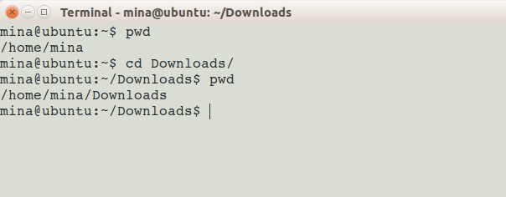
Directory and File Handling Commands, pwd
This section describes some of the more important directory and file handling commands.
pwd (print [current] working directory)
pwd displays the full absolute path to the your current location in the filesystem. So:

Slide 15
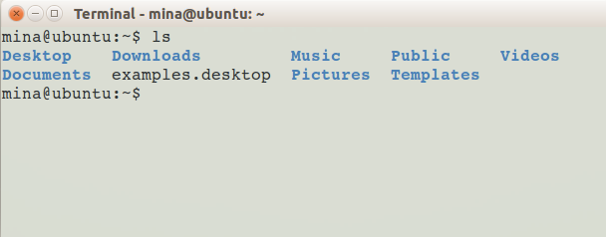
ls
ls (list directory)
ls lists the contents of a directory. If no target directory is given, then the contents of the current working directory are displayed. So, if the current working directory is /,

Slide 16
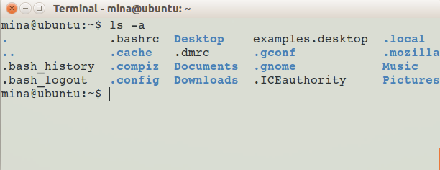
ls
Actually, ls doesn't show you all the entries in a directory - files and directories that begin with a dot (.) are hidden (this includes the directories '.' and '..' which are always present). The reason for this is that files that begin with a . usually contain important configuration information and should not be changed under normal circumstances. If you want to see all files, ls supports the -a option:

Slide 17
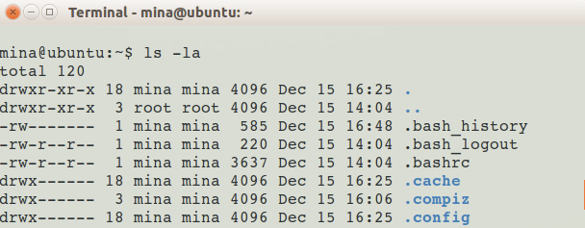
ls
Even this listing is not that helpful - there are no hints to properties such as the size, type and ownership of files, just their names. To see more detailed information, use the -l option (long listing), which can be combined with the -a option as follows:

Slide 18
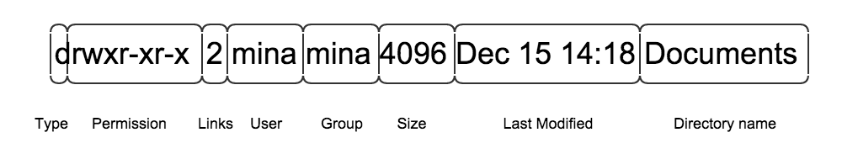
type is a single character which is either 'd' (directory), '-' (ordinary file), 'l' (symbolic link), 'b' (block-oriented device- data in blocks – hard drive) or 'c' (character-oriented device – byte by byte basis - modem).
permissions is a set of characters describing access rights. links refers to the number of filesystem links pointing to the file/directory.
owner is usually the user who created the file or directory.
group a collection of users who are allowed to access the file.
size is the length of a file.
date is the date when the file or directory was last modified.
name is the name of the file or directory.

Slide 19
Exercise
Now open a new terminal and run the following commands:
ls on the current directory
Print your current working directory
List all files and directories within your current working directory

Slide 20
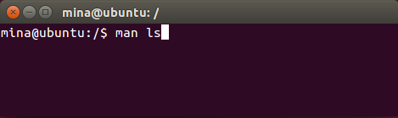
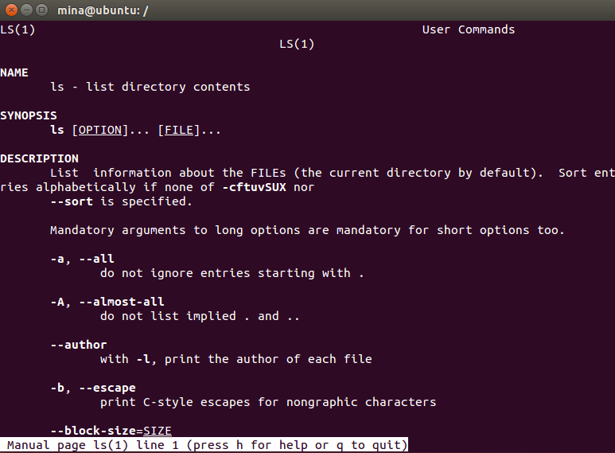
man
ls supports more options. To find out what they are, type:

Slide 21
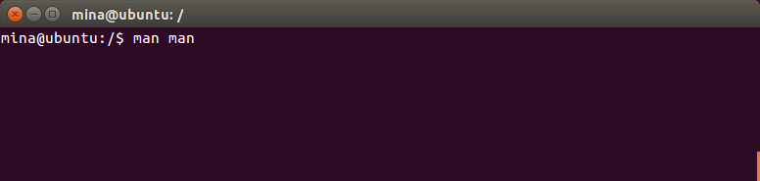
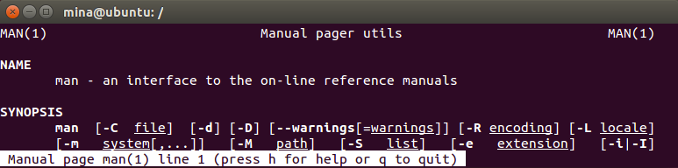
man
man is the interface used to view the system’s reference manuals
You can get more information about man by saying:
To quit the manual page press q and enter.

Slide 22
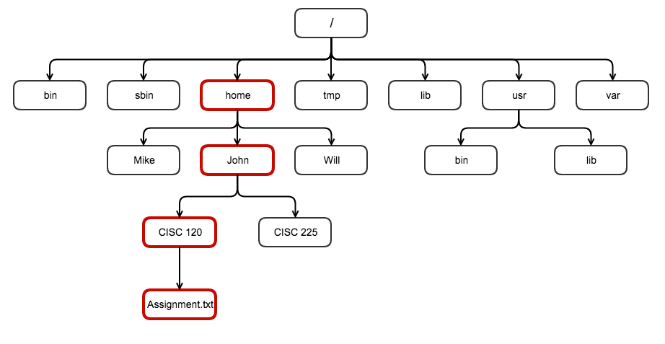
cd
If you are in your home directory and trying to reach the assignment file in the CISC 120 directory, then you will need the help of the cd command, cd stands for change directory.

Slide 23
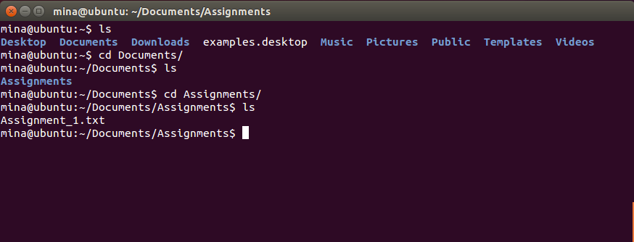
cd
To use the cd command you have to type the cd keyword first followed by the path:
$ cd path
Examples:

